Slide 1

Manager:
Organization: EAIESB Software Solutions
Staff:
Program: EAIESB
G
On Track/No Major Issues
EAIESB Weekly Status Report
Y
Behind Schedule Recoverable
R
Schedule at Risk / Major Issues
Status During 28-08-2023 oto 01-09-2023
Key Activities/Next Steps
Key Activities Completed
1. FlutterFlow Mobile App Development
| EAIESB Software Solutions™ Proprietary and confidential

Slide 2
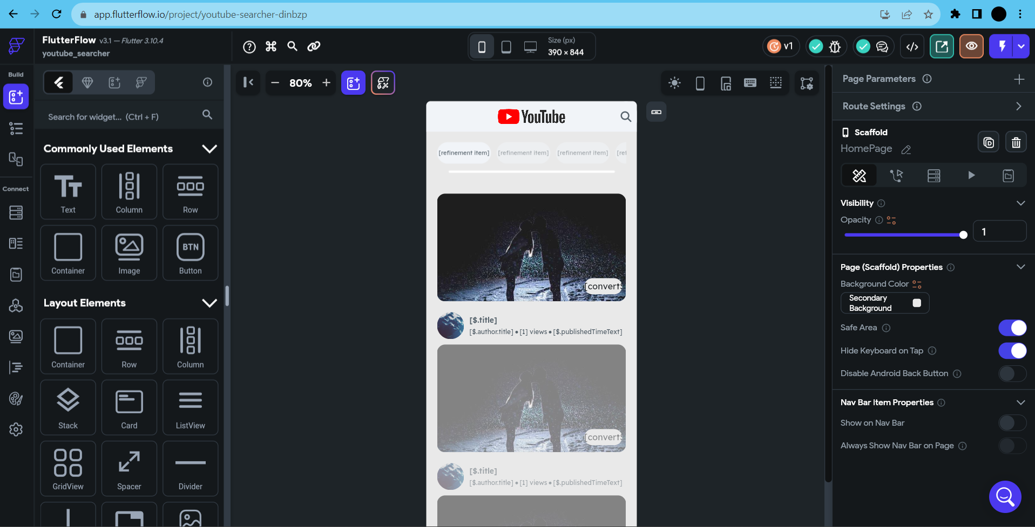
Manager:
Organization: EAIESB Software Solutions
Staff:
Program: EAIESB
G
On Track/No Major Issues
EAIESB Weekly Status Report
Y
Behind Schedule Recoverable
R
Schedule at Risk / Major Issues
Status During 28-08-2023 oto 01-09-2023
1. Youtube Searcher Mobile App
Building the app
| EAIESB Software Solutions™ Proprietary and confidential

Slide 3
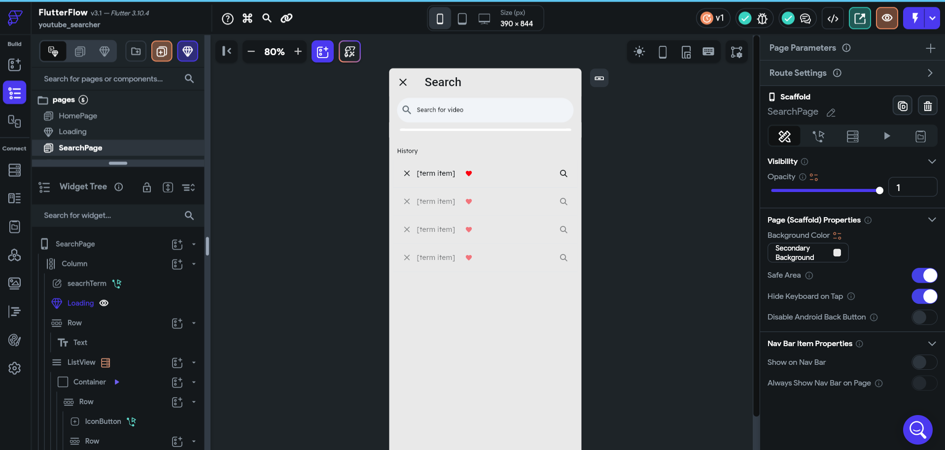
Manager:
Organization: EAIESB Software Solutions
Staff:
Program: EAIESB
G
On Track/No Major Issues
EAIESB Weekly Status Report
Y
Behind Schedule Recoverable
R
Schedule at Risk / Major Issues
Status During 28-08-2023 oto 01-09-2023
| EAIESB Software Solutions™ Proprietary and confidential

Slide 4
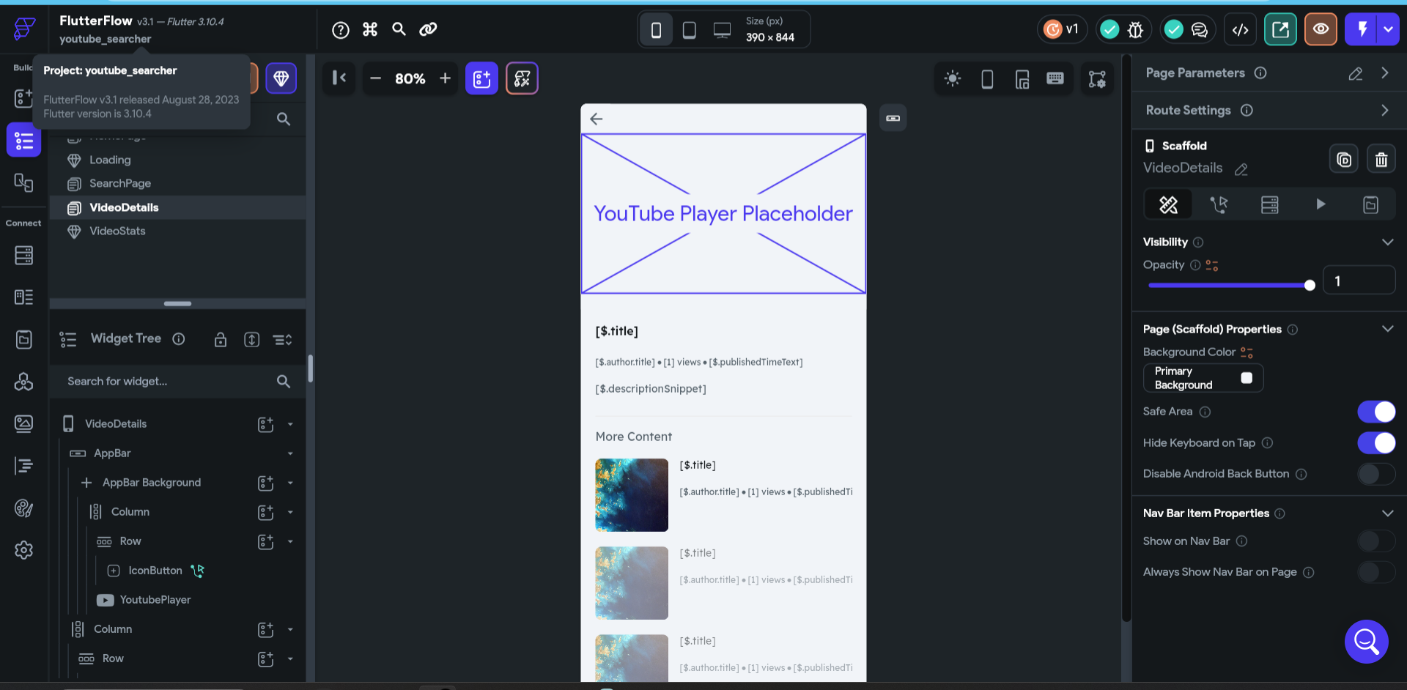
Manager:
Organization: EAIESB Software Solutions
Staff:
Program: EAIESB
G
On Track/No Major Issues
EAIESB Weekly Status Report
Y
Behind Schedule Recoverable
R
Schedule at Risk / Major Issues
Status During 28-08-2023 oto 01-09-2023
| EAIESB Software Solutions™ Proprietary and confidential

Slide 5

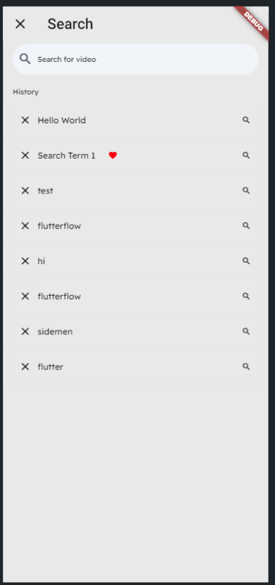

Manager:
Organization: EAIESB Software Solutions
Staff:
Program: EAIESB
G
On Track/No Major Issues
EAIESB Weekly Status Report
Y
Behind Schedule Recoverable
R
Schedule at Risk / Major Issues
Status During 28-08-2023 oto 01-09-2023
Mobile app Model
| EAIESB Software Solutions™ Proprietary and confidential

Slide 6
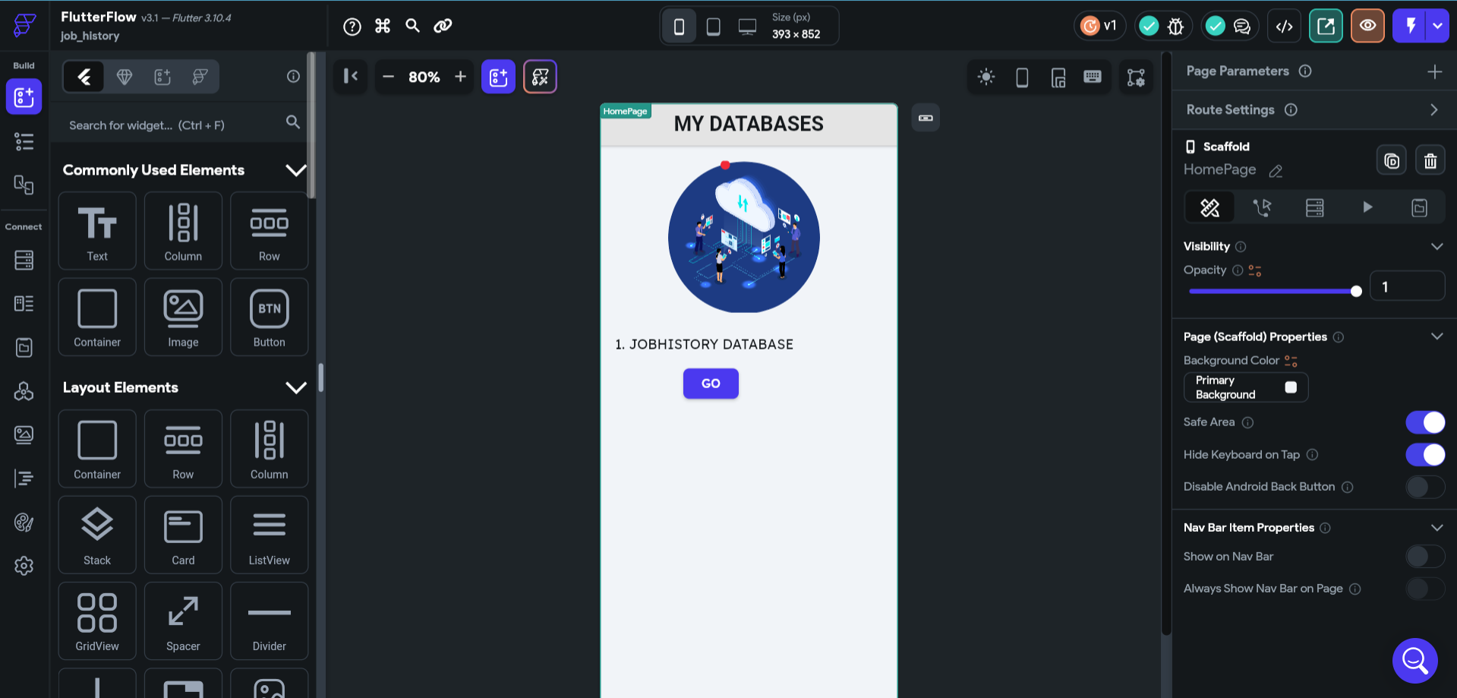
Manager:
Organization: EAIESB Software Solutions
Staff:
Program: EAIESB
G
On Track/No Major Issues
EAIESB Weekly Status Report
Y
Behind Schedule Recoverable
R
Schedule at Risk / Major Issues
Status During 28-08-2023 oto 01-09-2023
2. JobHistory Database App
Building the app
| EAIESB Software Solutions™ Proprietary and confidential

Slide 7
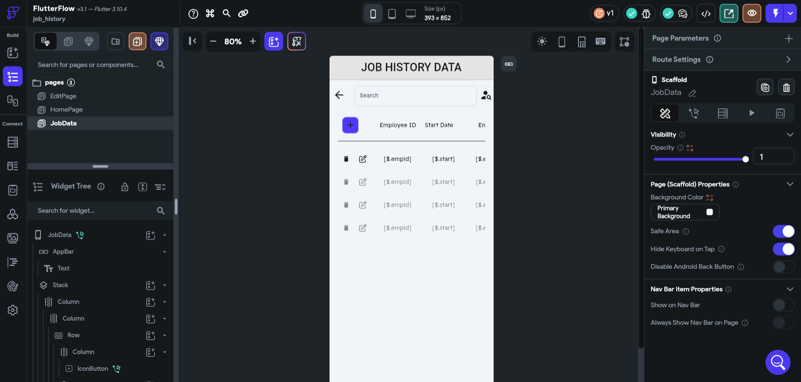
Manager:
Organization: EAIESB Software Solutions
Staff:
Program: EAIESB
G
On Track/No Major Issues
EAIESB Weekly Status Report
Y
Behind Schedule Recoverable
R
Schedule at Risk / Major Issues
Status During 28-08-2023 oto 01-09-2023
| EAIESB Software Solutions™ Proprietary and confidential

Slide 8
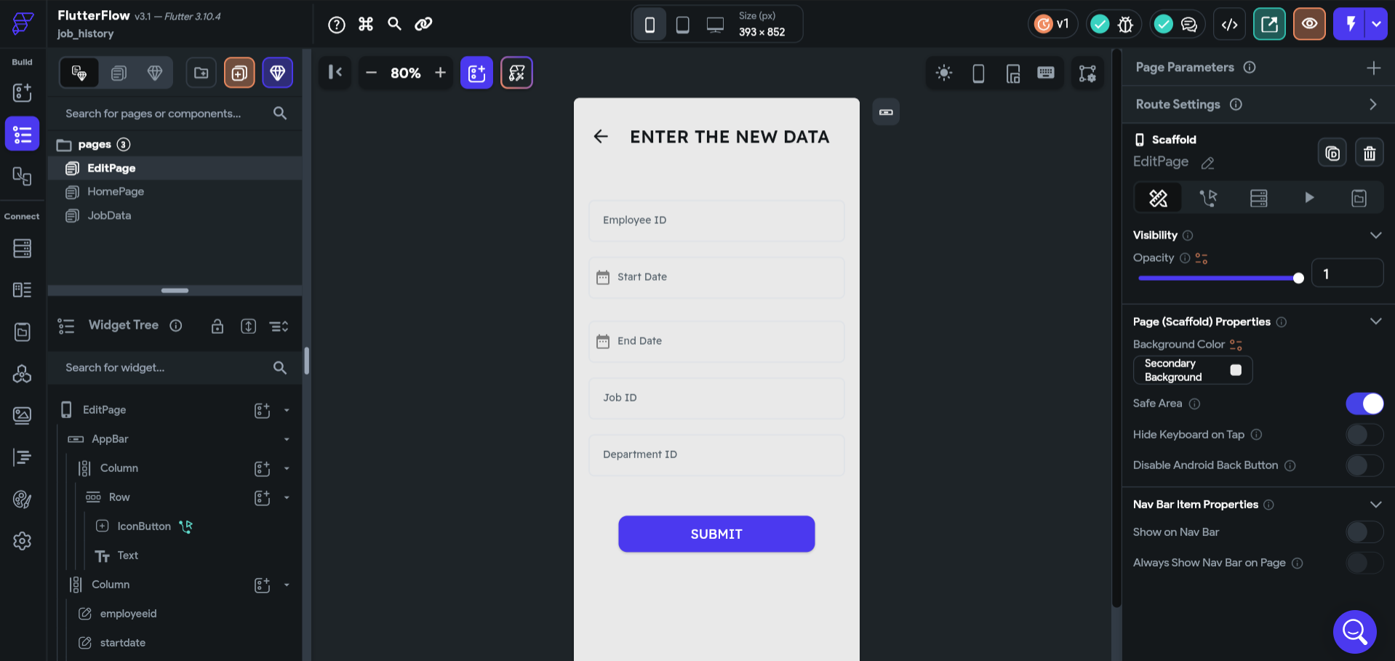
Manager:
Organization: EAIESB Software Solutions
Staff:
Program: EAIESB
G
On Track/No Major Issues
EAIESB Weekly Status Report
Y
Behind Schedule Recoverable
R
Schedule at Risk / Major Issues
Status During 28-08-2023 oto 01-09-2023
| EAIESB Software Solutions™ Proprietary and confidential

Slide 9

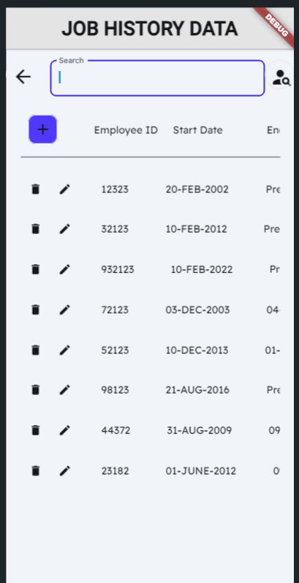
Manager:
Organization: EAIESB Software Solutions
Staff:
Program: EAIESB
G
On Track/No Major Issues
EAIESB Weekly Status Report
Y
Behind Schedule Recoverable
R
Schedule at Risk / Major Issues
Status During 28-08-2023 oto 01-09-2023
Mobile app Model
| EAIESB Software Solutions™ Proprietary and confidential

Slide 10
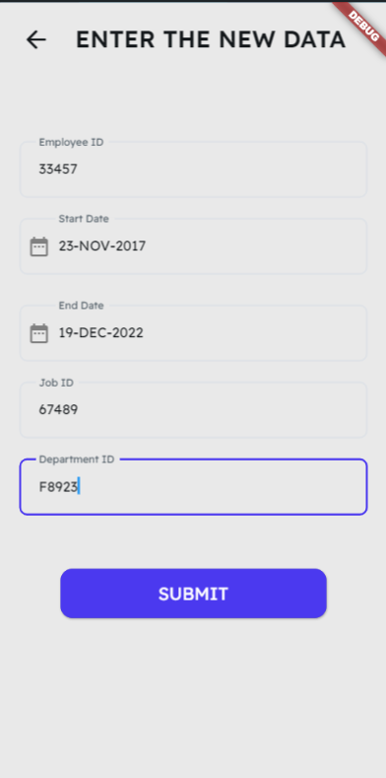
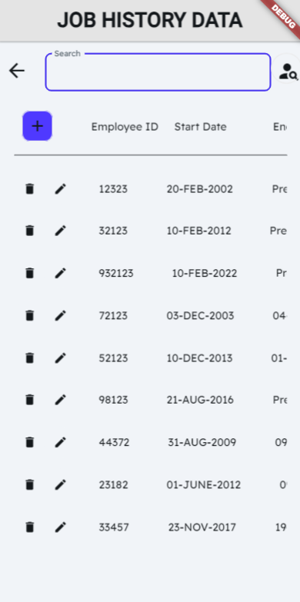
Manager:
Organization: EAIESB Software Solutions
Staff:
Program: EAIESB
G
On Track/No Major Issues
EAIESB Weekly Status Report
Y
Behind Schedule Recoverable
R
Schedule at Risk / Major Issues
Status During 28-08-2023 oto 01-09-2023
| EAIESB Software Solutions™ Proprietary and confidential

Slide 11
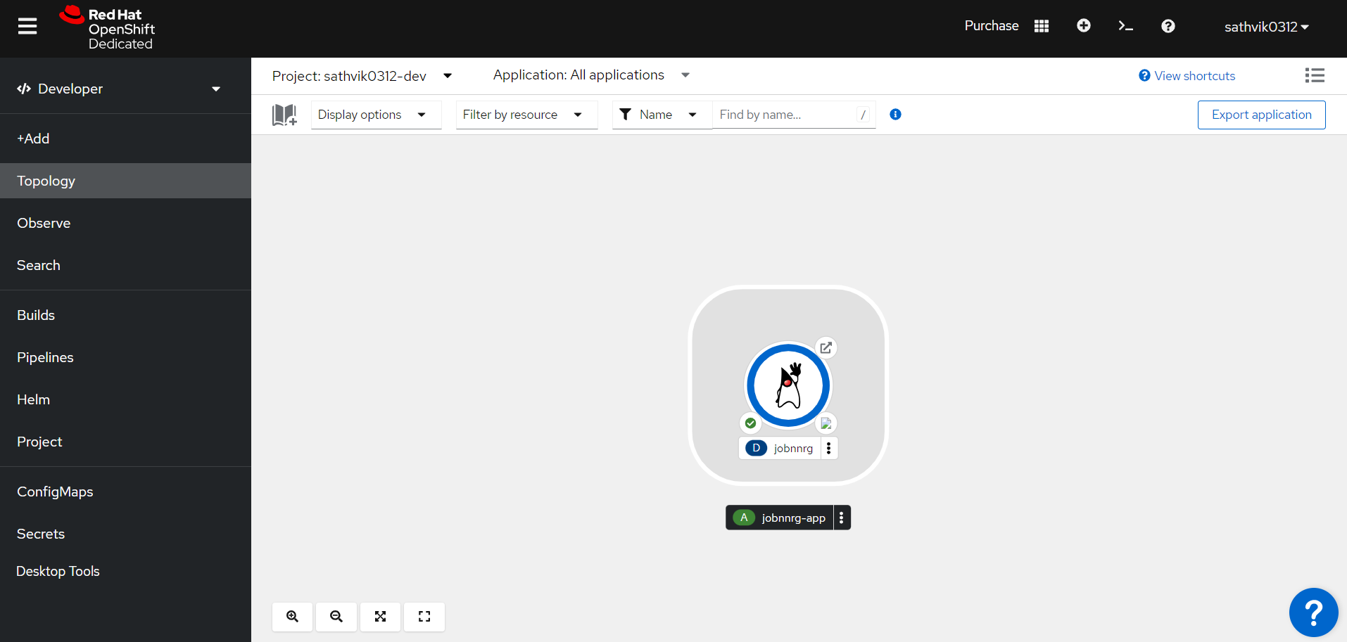
Manager:
Organization: EAIESB Software Solutions
Staff:
Program: EAIESB
G
On Track/No Major Issues
EAIESB Weekly Status Report
Y
Behind Schedule Recoverable
R
Schedule at Risk / Major Issues
Status During 28-08-2023 oto 01-09-2023
RedHat Deployment
| EAIESB Software Solutions™ Proprietary and confidential

Slide 12
G
On Track/No Major Issues
Manager:
Organization: EAIESB Software Solutions
Staff:
Program: EAIESB
EAIESB Weekly Status Report
Y
Behind Schedule Recoverable
R
Schedule at Risk / Major Issues
Status During 28-08-2023 oto 01-09-2023
GITHUB ACCOUNT
https://github.com/SATHVIK0312/EAIESB-INTERSHIP
LINKDIN ACCOUNT
https://www.linkedin.com/in/sangaraju-sai-sathvik-varma-b01a89270/
| EAIESB Software Solutions™ Proprietary and confidential

Slide 13

Manager:
Organization: EAIESB Software Solutions
Staff:
Program: EAIESB
On Track/No Major Issues
G
EAIESB Weekly Status Report
Y
Behind Schedule Recoverable
R
Schedule at Risk / Major Issues
Status During 28-08-2023 oto 01-09-2023
| EAIESB Software Solutions™ Proprietary and confidential

